Slide 1
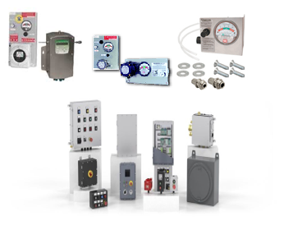
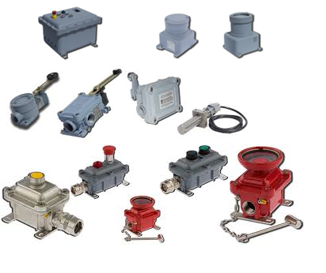
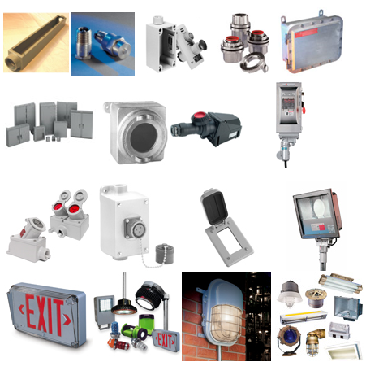
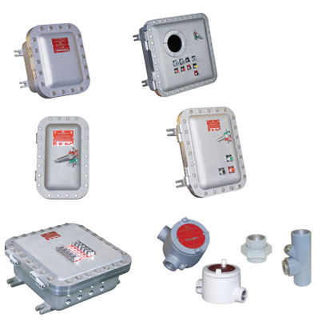
Product Line
Explosion Proof Ex d:
NEC, ATEX & IECEX Cast Aluminium & Stainless steel
Junction box, control panel, motor starter junction box, control station panel, panel board, circuit breaker enclosure & conduit outlet box

Slide 2
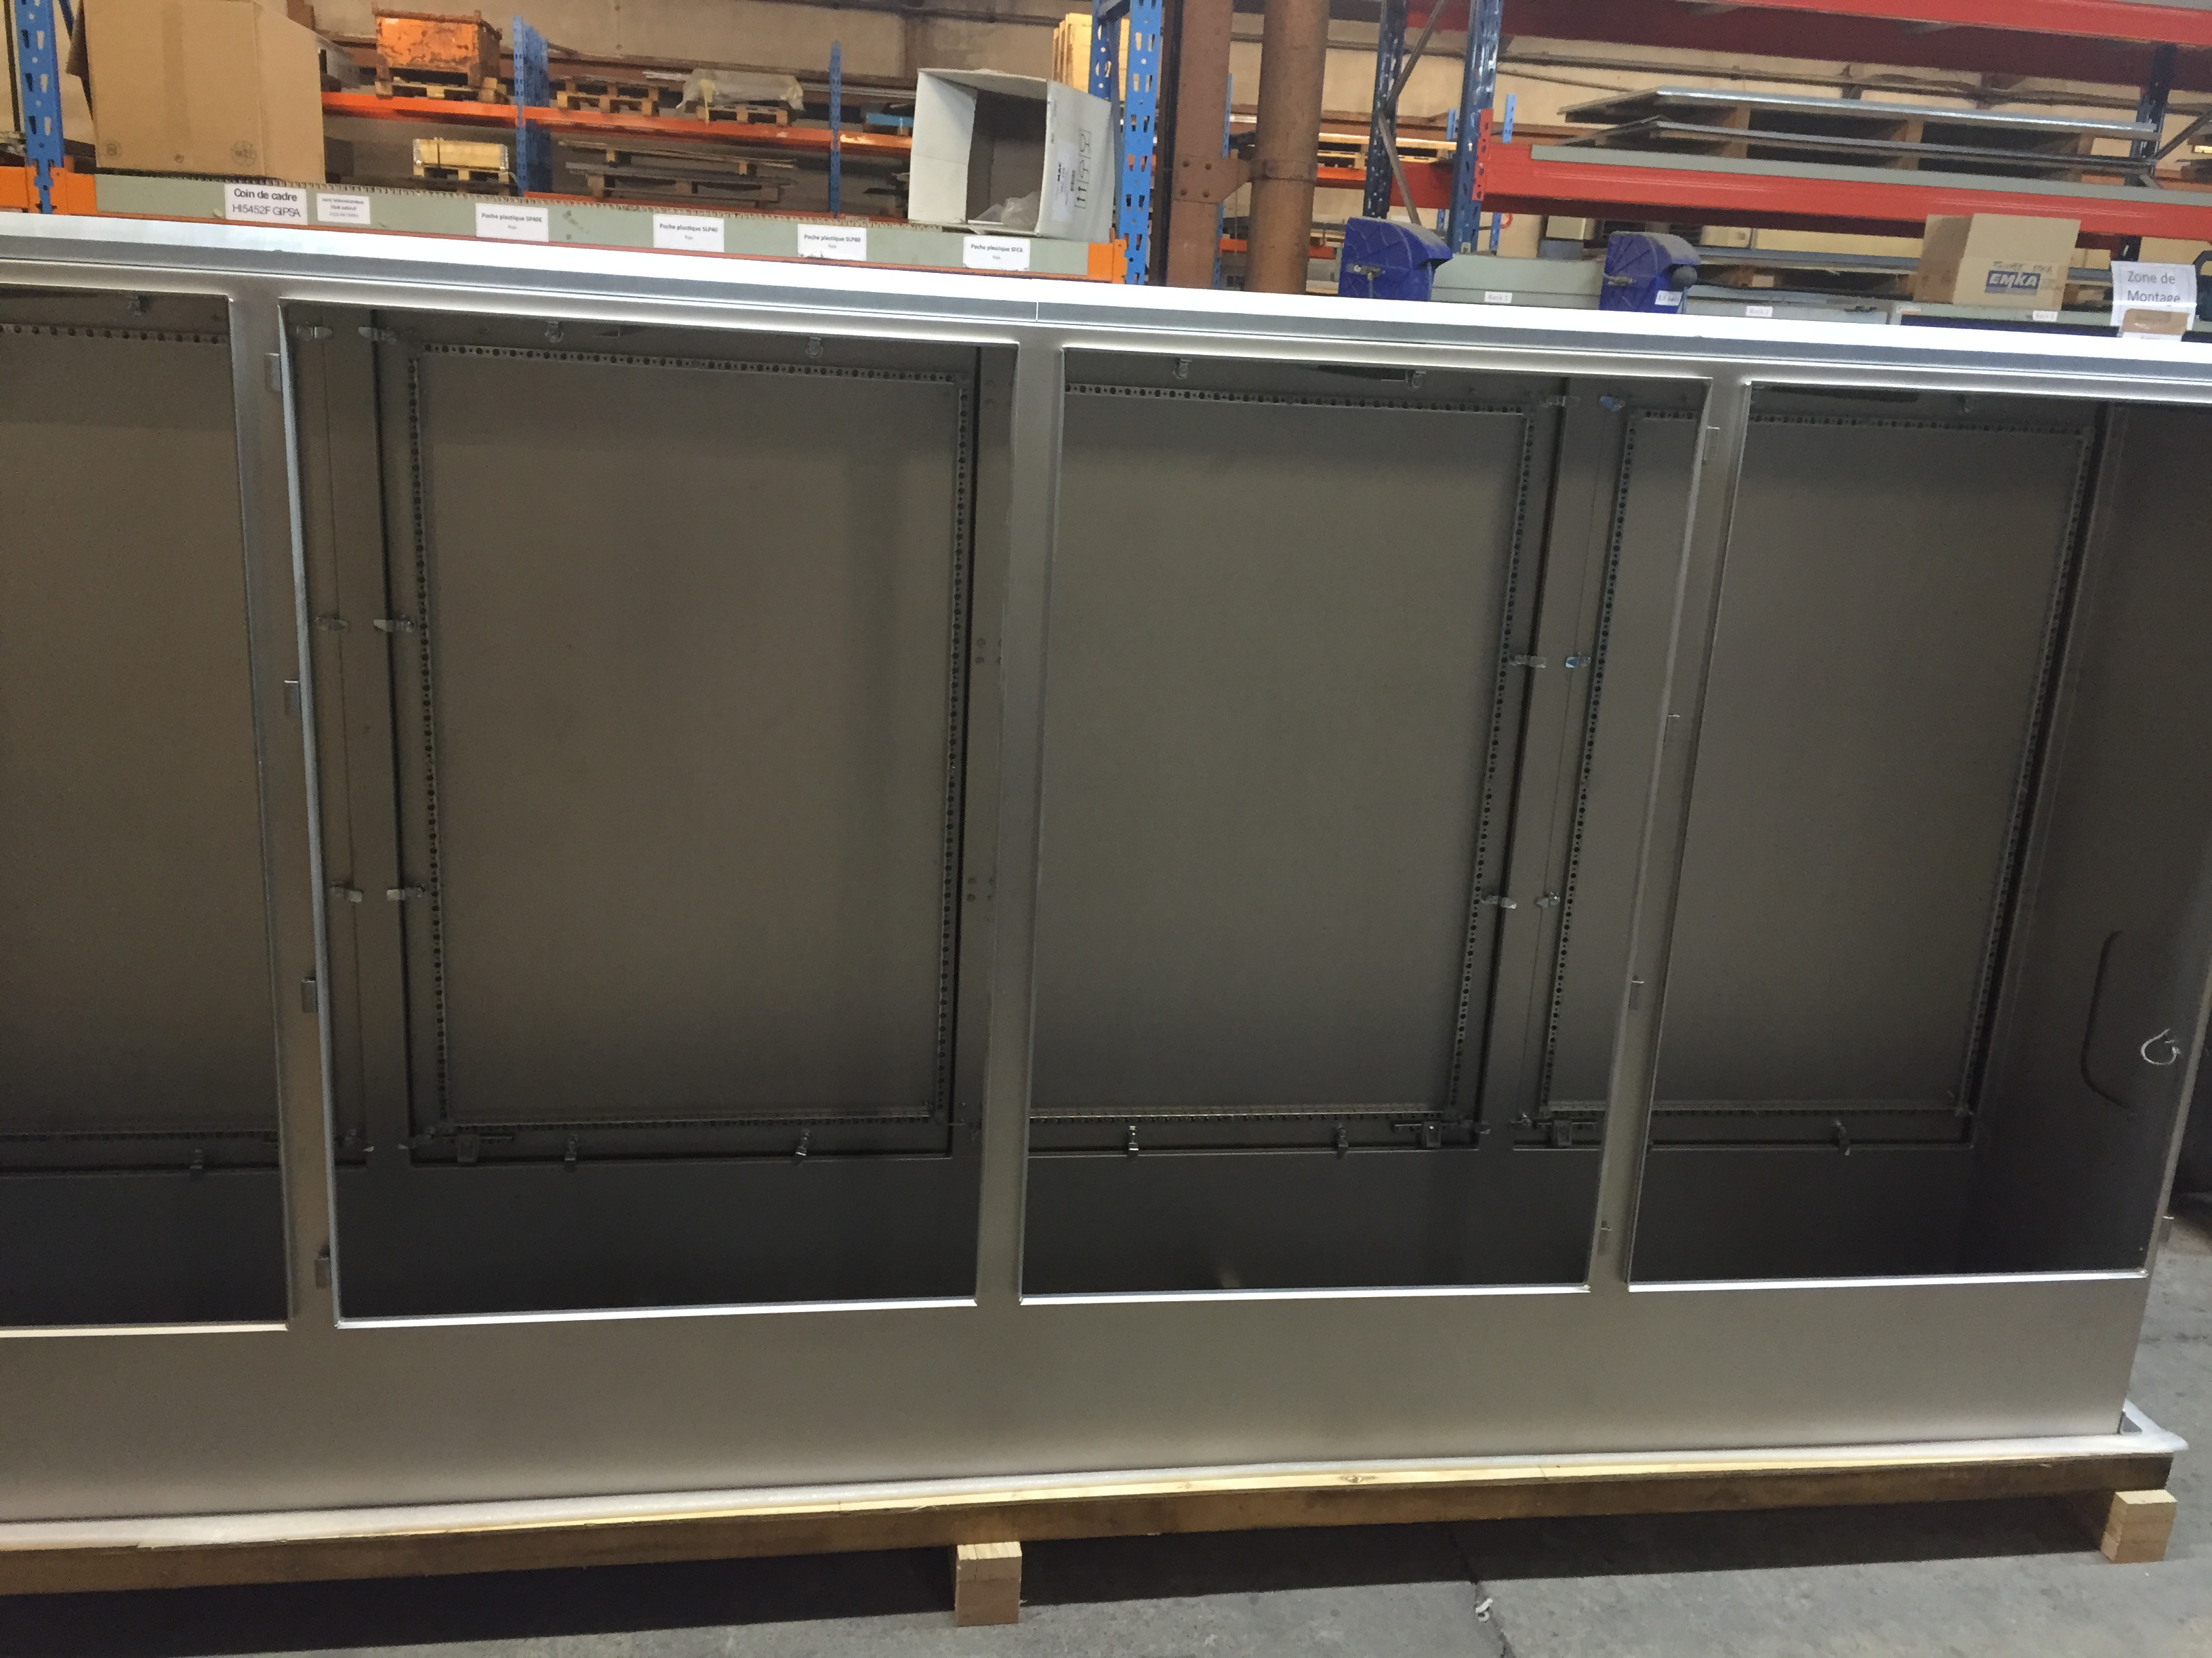
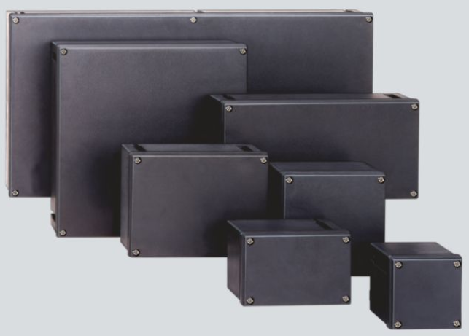
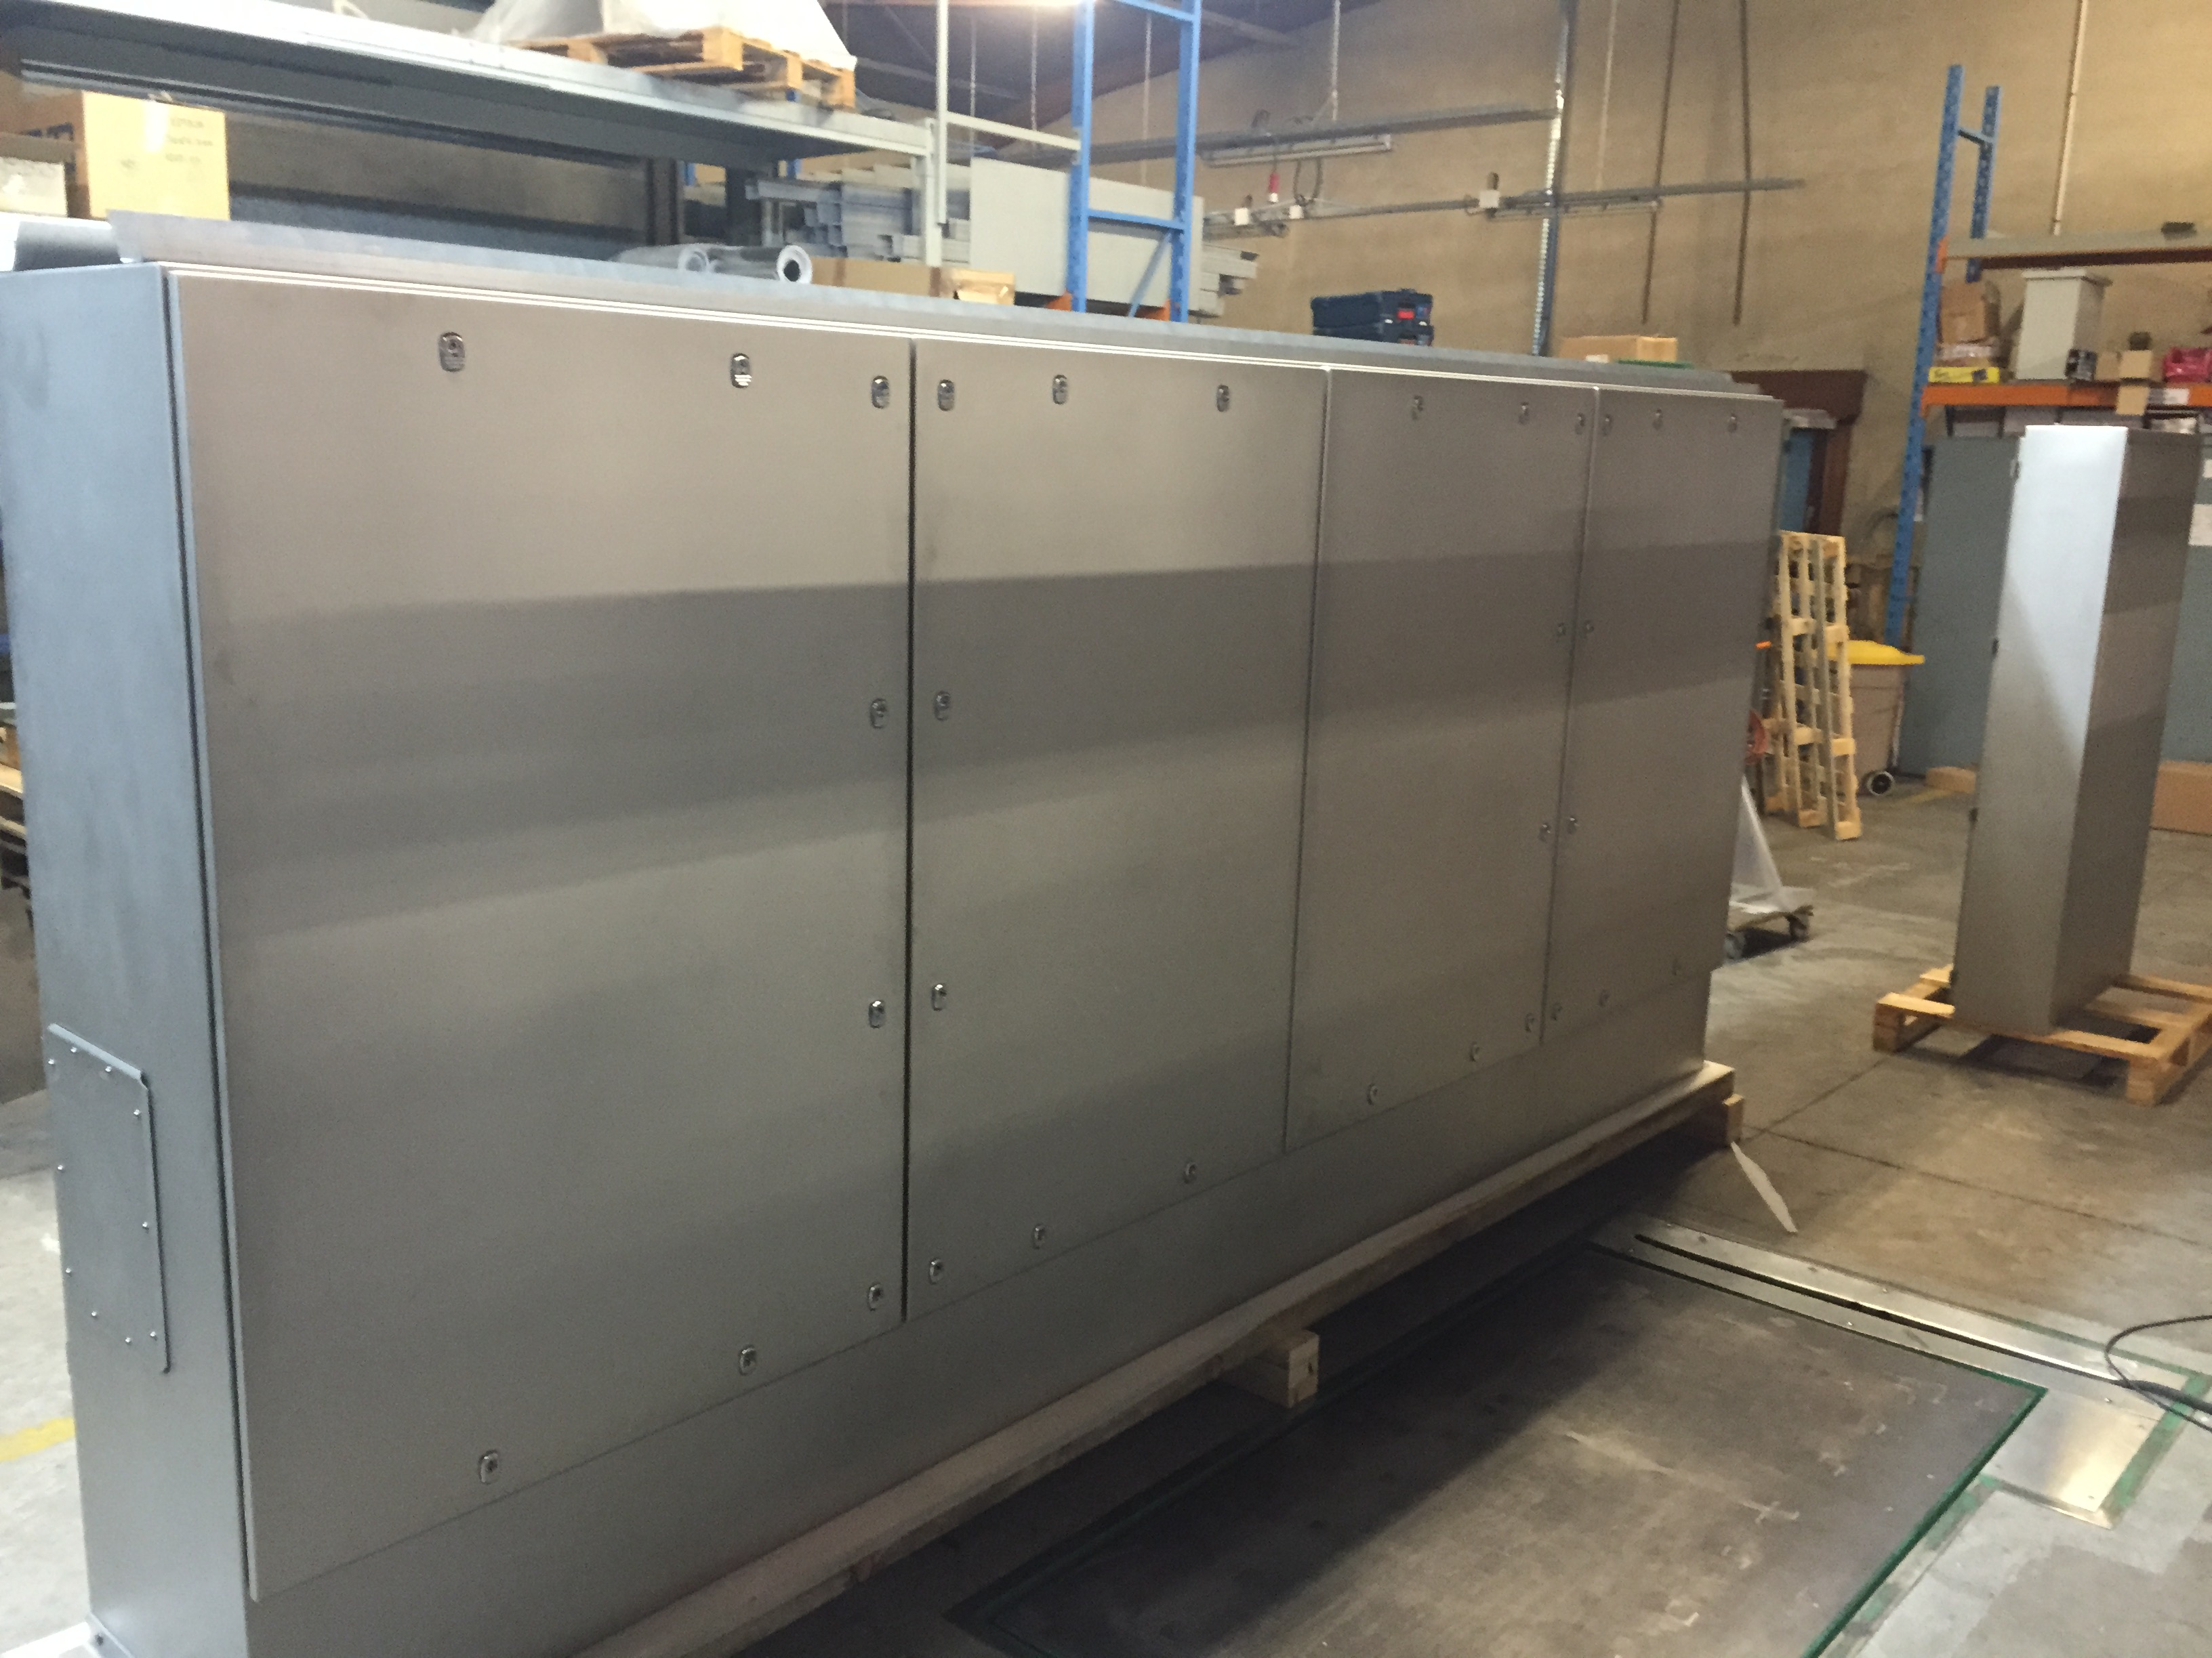
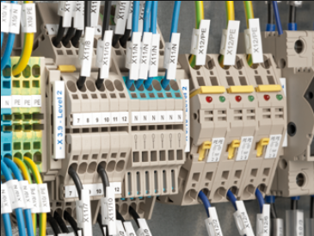
Product Line
Explosion Protected Ex de, e:
Hazardous enclosure suitable for control station, conduit outlet box and control panel

Slide 3
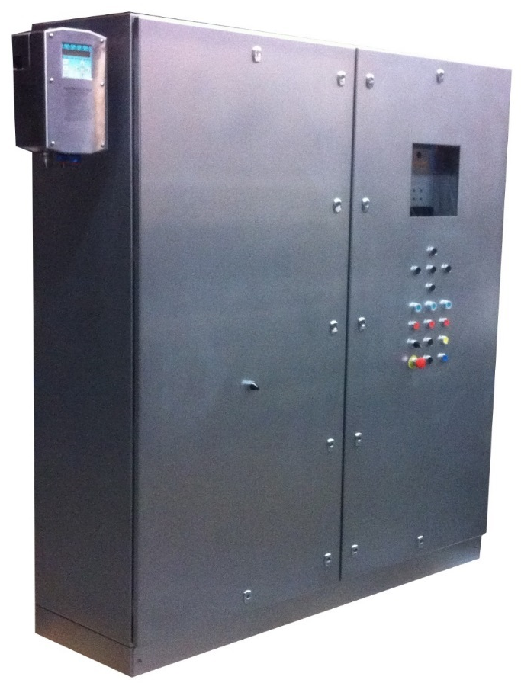
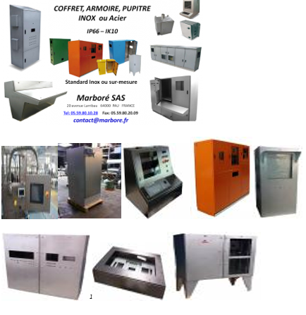
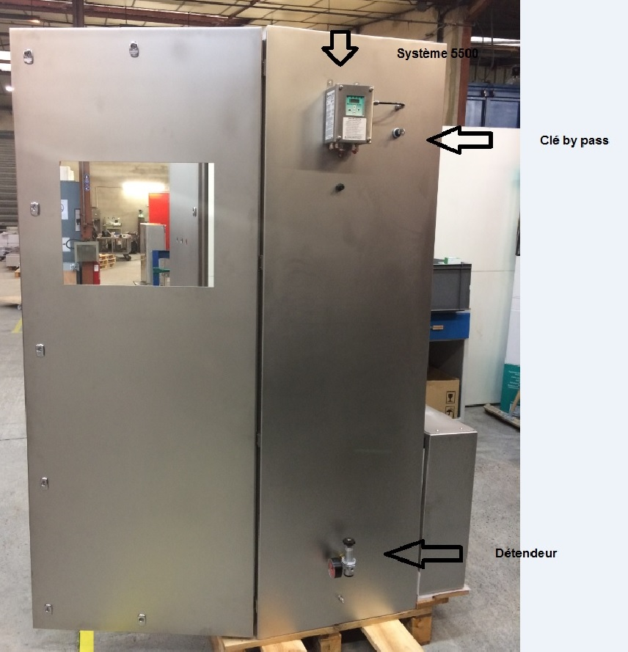
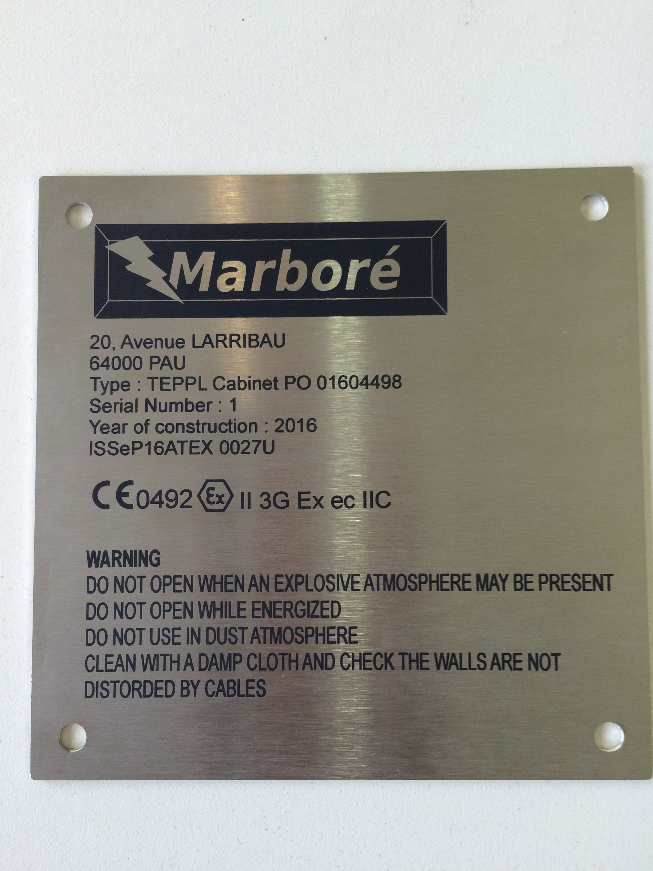
Product Line
Purge + Pressurization Systems (Ex pz):
Complete ATEX /IECEX Certification on customised enclosures from wall mount to floor standing to meet Zone 1 & 2 areas.

Slide 4
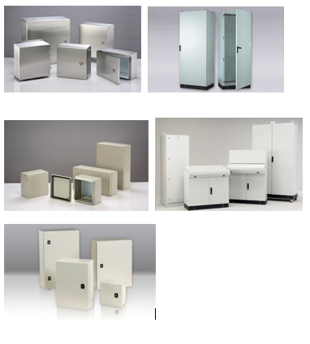
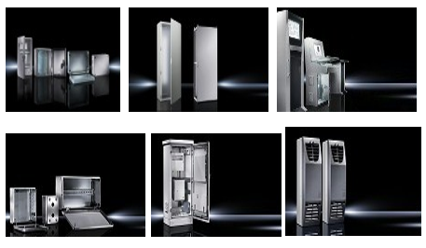
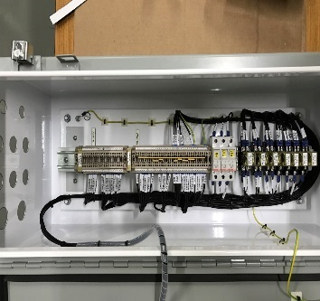
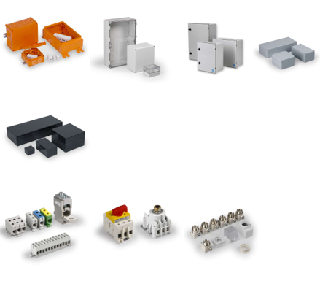
Product Line
Industrial application:
Industrial weather proof enclosure with ingress protection (IP) rated for control panel

Slide 5
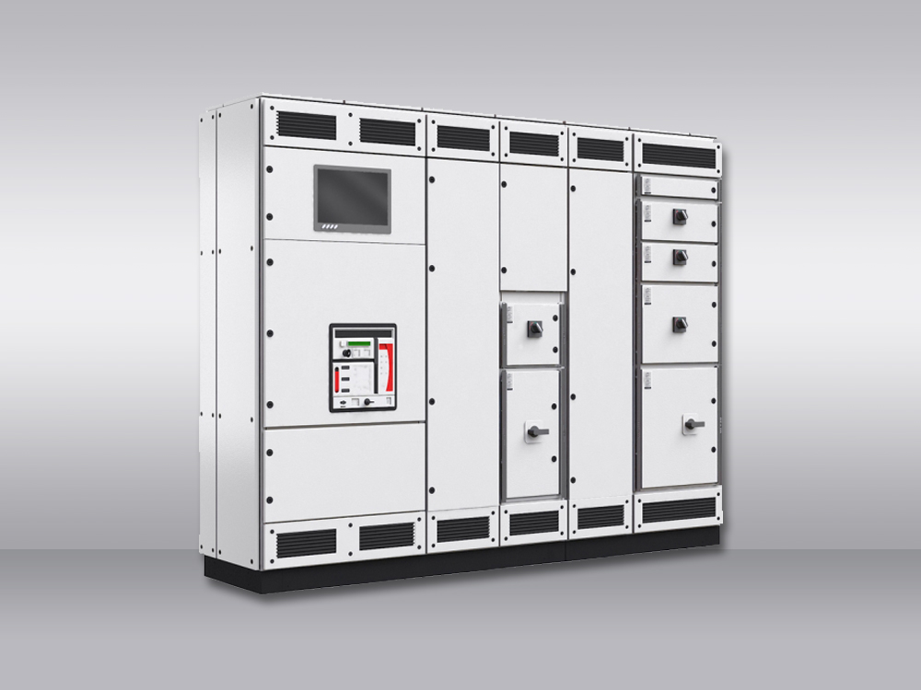
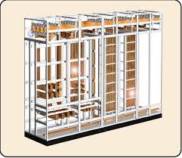
Product Line
Industrial application:
IEC Low Voltage switchboard / MCC / MOV panel

Slide 6
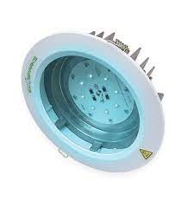
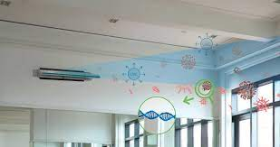
Product Line
EcoSparks LED UV-C Air & Surface Disinfection Solution
Compliant with International Electrical Safety Standard

Slide 7
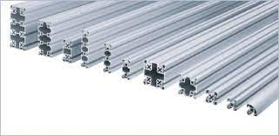
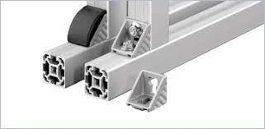
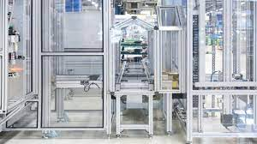
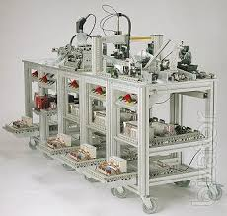
Product Line
Rexroth Bosch
Aluminium profiles – solutions & components

